Slide 1
Web Development
CSE343
Lab 5

Slide 2
Intro to React

Slide 3
What is React?
React is a Frontend Library that makes frontend development easier and more scalable. How?
Let’s discuss how after we see some React code…
Search “react playground CodeSandbox” to start using react
Don’t worry if you don’t understand the code. It’s just for demonstration purposes
App.js - nodebox - CodeSandbox

Slide 4
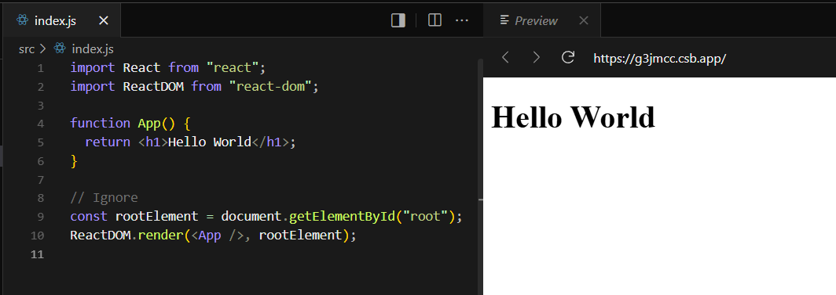
Some React code
Looks familiar, doesn’t it?
Let’s try something else…

Slide 5
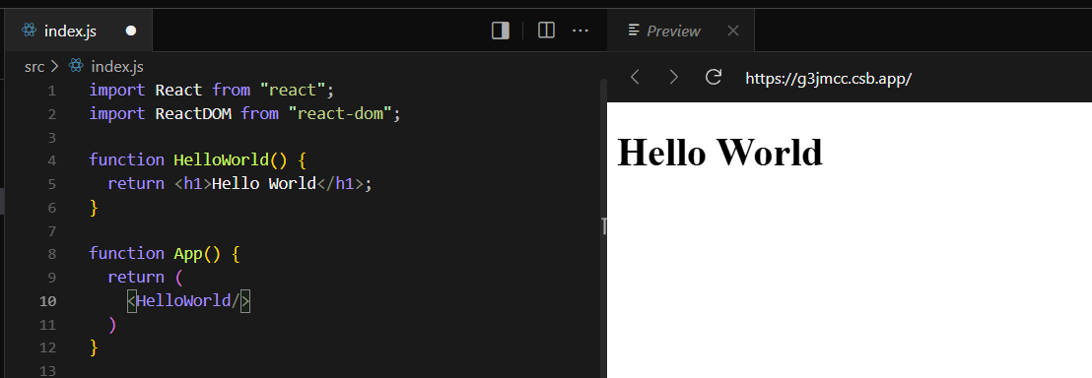
Some React code
Some function
Our page
So, we can write some html in some function, then use that function inside our page…
Let’s try something else

Slide 6
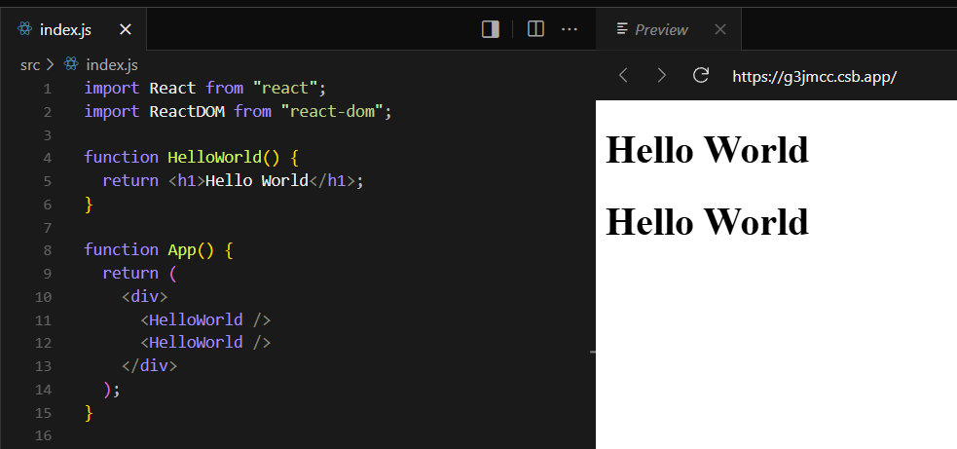
Some React code
Some function
Our page
Notice how we used this HelloWorld function twice in our page

Slide 7
Why React
As we saw, in react you can create some “html” in some function and reuse it elsewhere.
That’s one powerful key feature in React where we can write our components once and reuse it instead of copying and pasting it.
There are several other features in React that frontend development easier and scalable. We will explore them as we go.

Slide 8
Some React terms
This function that contains html is called a component
The language that react uses is called jsx. It looks like html but can run javascript inside it.
We use jsx to build components and compose our UI using these components.

Slide 9
Let’s learn React
In this lab, we will be walking through the quick start guide in react.dev

Slide 10
Let’s learn React – Components
React apps are made out of components. A component is a piece of the UI (user interface) that has its own logic and appearance. A component can be as small as a button, or as large as an entire page.
React components are JavaScript functions that return markup

Slide 11
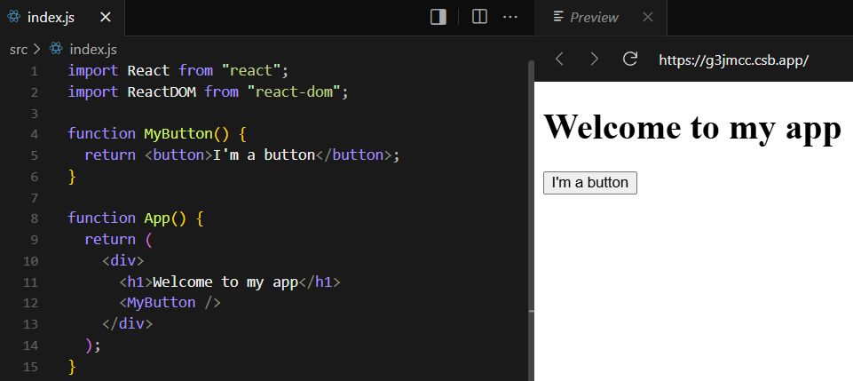
Let’s learn React
React Component
React components must start with capital letters to differentiate them from regular html tags

Slide 12
Let’s learn React – Styling
React does not enforce a way to add styles to your components. You can create a .css file and import it or use inline style or use one of the many other ways to style in react.
For the sake of simplicity, let’s use inline styles for now.

Slide 13
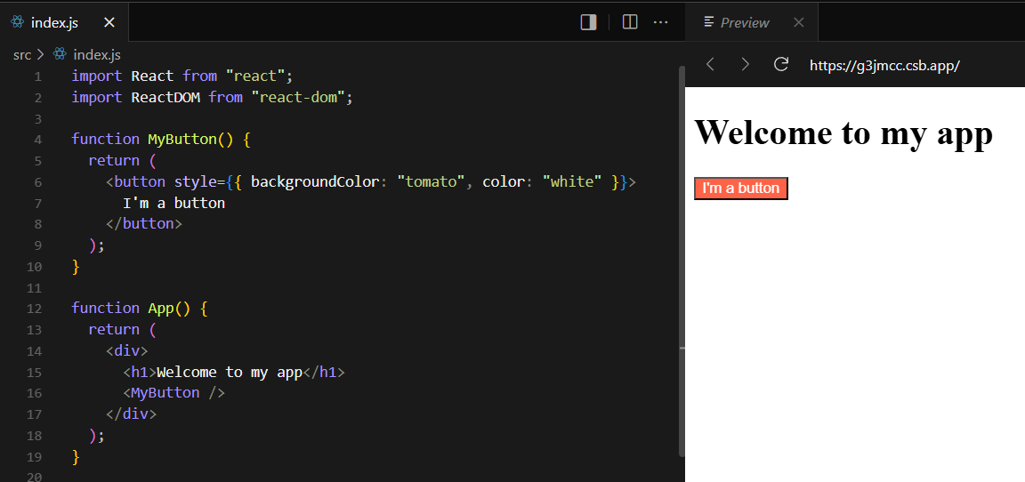
Let’s learn React

Slide 14
Let’s learn React – Displaying Data
Inside your markup section, you can run javascript using curly braces

Slide 15
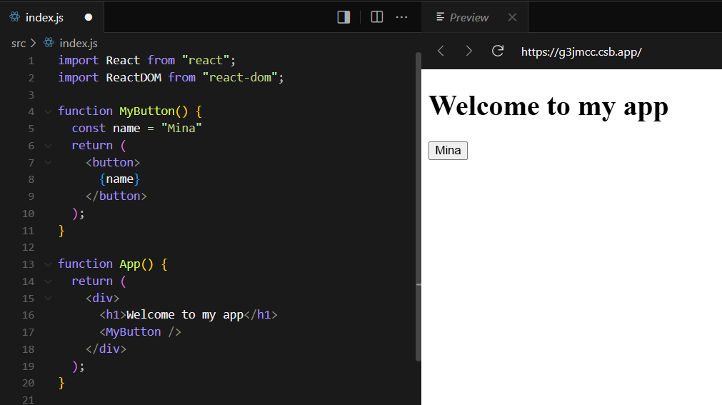
Let’s learn React – Displaying Data

Slide 16
Let’s learn React – Displaying Data
Let’s try something more complex like displaying a list

Slide 17
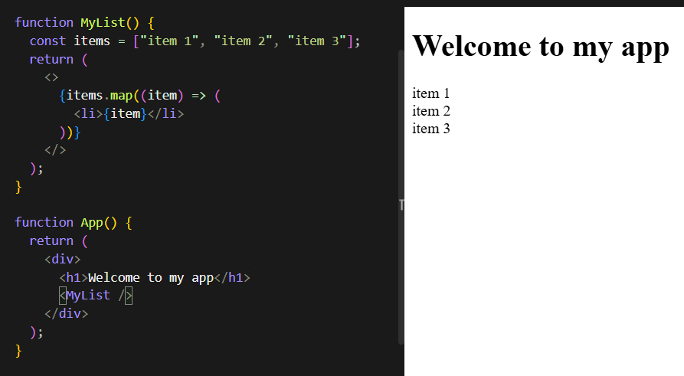
Let’s learn React – Displaying Data

Slide 18
Let’s learn React – Displaying Data
We can even conditionally render components

Slide 19
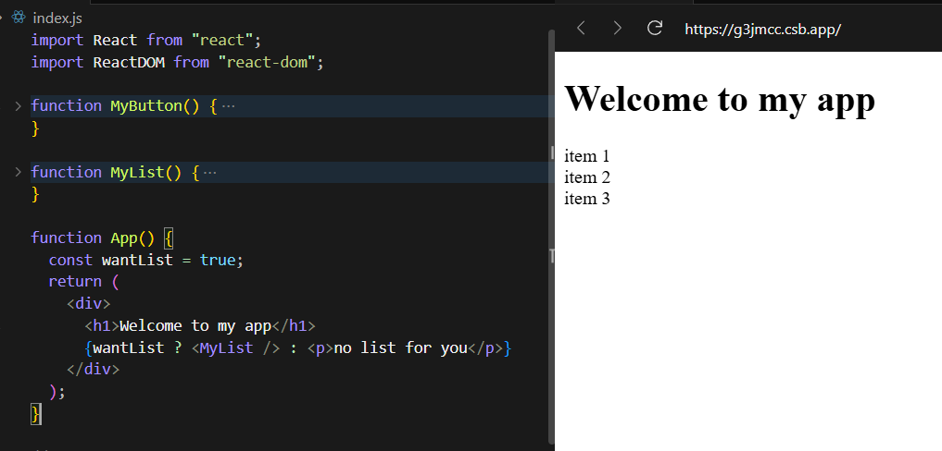
Let’s learn React – Displaying Data

Slide 20
Let’s learn React – Updating the screen
Often, you’ll want your component to “remember” some information and display it
For example: in our to do app, that was the content of the list. In the calculator, that the value displayed on the screen
To do this in React, we use useState
You’ll get two things from useState: the current state (count), and the function that lets you update it (setCount). You can give them any names, but the convention is to write [something, setSomething]

Slide 21
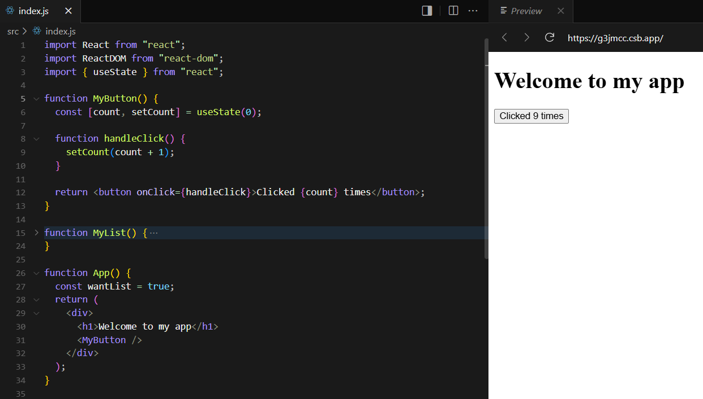
Let’s learn React – Displaying Data

Slide 22
Let’s learn React – Updating the screen
Recall: Before, if we wanted to update the screen, we used to get the element and manually set its content. For example, your render function in the to do app or display in the calculator
In React, we do this by simply updating the state variable and react automatically handles updating the UI
We declared that the count variable should be displayed inside the button. When it’s updated, React automatically re-renders the component and therefore updates the screen
This style for programming is called Declarative Programming. You declare what the end result should be, but you don’t worry how it will be achieved

Slide 23
Let’s learn React – Sharing data between components
In the previous example, the count state/variable was inside the button component
That means that no one can access it from outside the button
What if we want to have 2 buttons, one for increment and one for decrement
We use props… Props are basically passing arguments to the component
Let’s see how we can achieve the counter increment/decrement

Slide 24
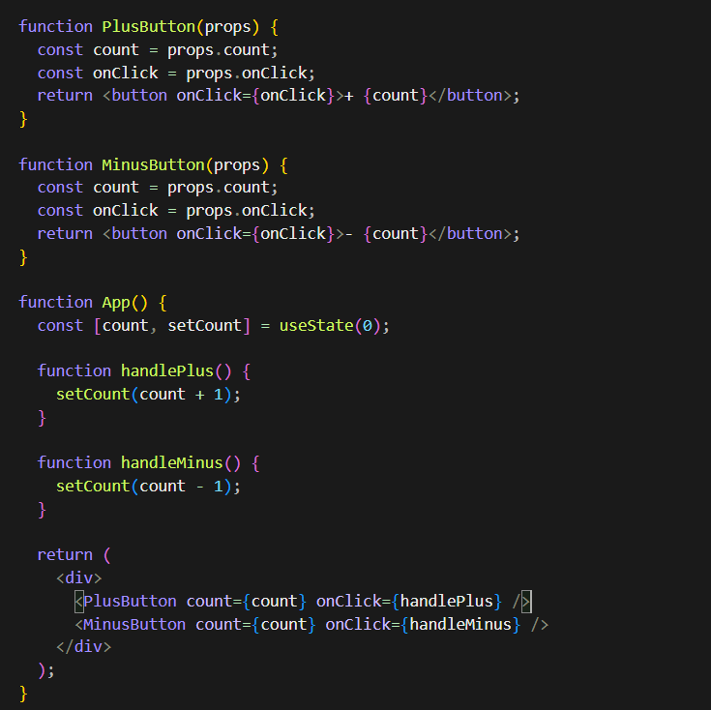
Each component is called with a parameter called “props”. This parameter will contain what ever you pass down when you call the component from the parent.
Here we included the count variable and a callback function to handle the button click

Slide 25
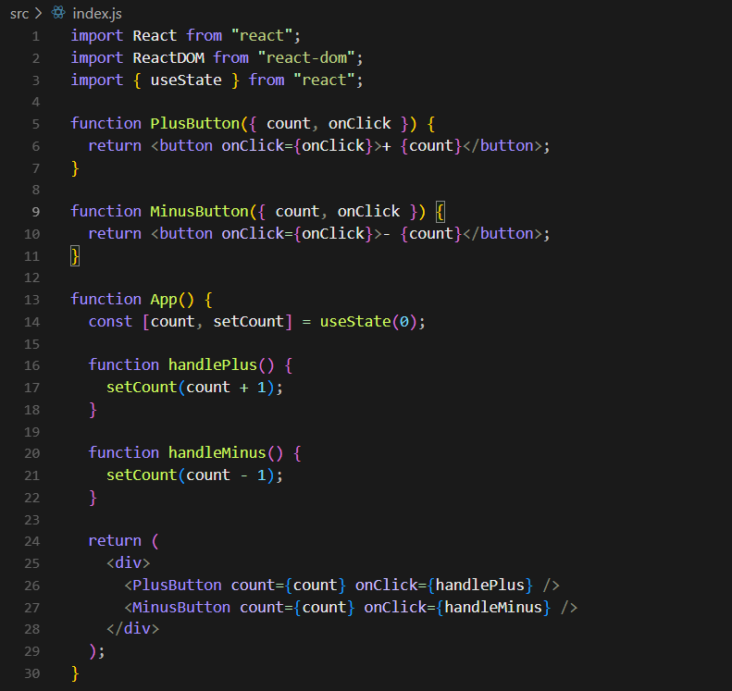
You can destructure the received props like so ->

Slide 26
Why React?
Now let’s answer this question from what we understood:
React allows us to write components once and reuse them everywhere. Companies create their UI library of React components and frontend devs compose the UI from these components. Now that’s scalable!
Declarative programming: no need to worry about manually updating the UI
Huge ecosystem of libraries that can save you a lot of work

Slide 27
Lab task
Movies watch list: app for saving the movies that you watch along with their rating.
Requirements
Add, remove movies to the list
Adding a comment review to the movie
Add a starts rating to the movie.
Show how many starts you have given to the movie using emojies ⭐
You can use AI for styling but NOT for React related work.
Use the react docs.

